Slide 1
Notions of Justice and Effectiveness

Slide 2
Principles
As principles, justice and effectiveness are not descriptions of the world. They are standards that we can measure our world against. We can see how close we are to achieving this ideal.

Slide 3
JUSTICE: Substantive and Procedural
Substantive justice is when people are “treated in the way they deserve”. This could be based on the “weight of contributions” or on “need.”
Procedural justice refers to “the procedures by which decisions are reached about people.” Think of due process (a fair trial, etc.).
What would be the elements of a “just” grading system?

Slide 4
The Issues With Procedural Justice
Arbitrary: Is it non-transparent? Does it single out particular individuals in an inappropriate way?
Special Basic Rights (civil liberties for individuals)
Overriding Social Needs

Slide 5
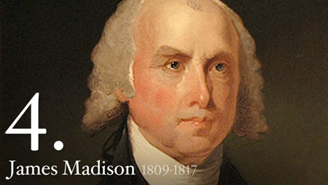
Why the need for procedures?
“If men were angels, no government would be necessary. If angels were to govern men, neither external nor internal controls on government would be necessary.”
-Federalist #51

Slide 6
What would be the criteria for a “Just” distribution of income?

Slide 7
What would be the criteria for a just system of taxation?
Should it be progressive?
Should it be flat?
Should each individual pay a fixed amount?

Slide 8
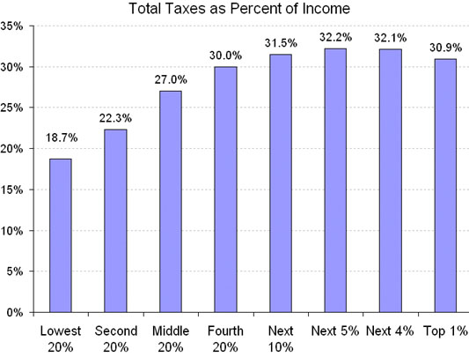

Slide 9

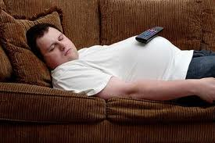
Should Everyone Be Paid the Same?

Slide 10
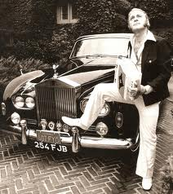
Would it be just to award income based on accordion proficiency?

Slide 11
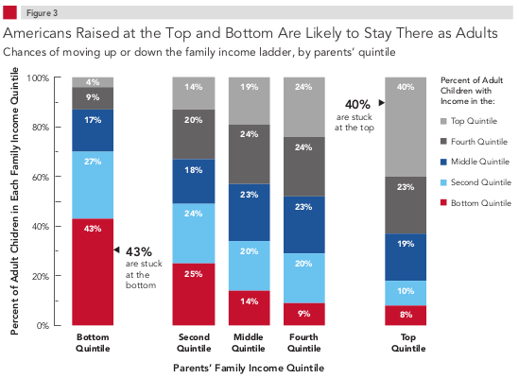
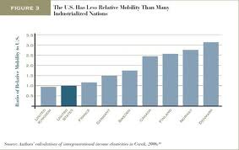
How much does birth influence your income?

Slide 13
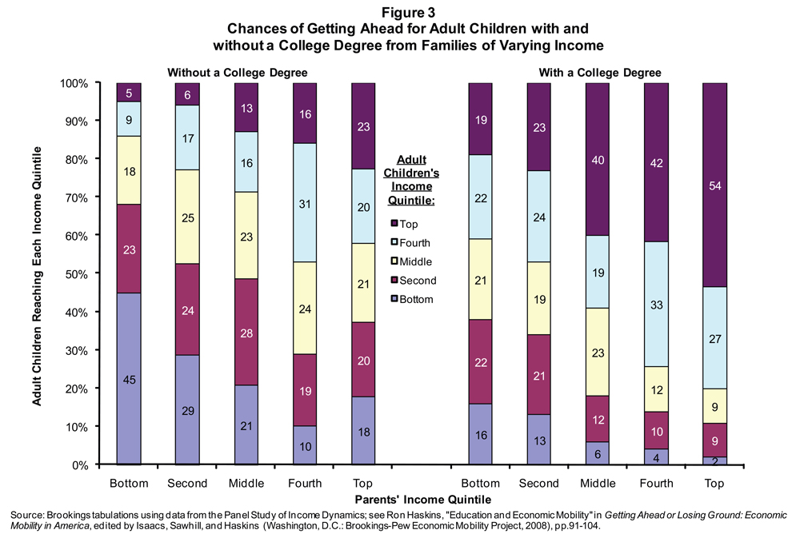

Slide 14
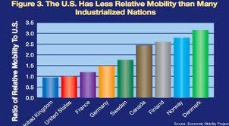

Slide 15
Effectiveness
A policy that “gives the state and the people of the state the greatest benefits at the least cost”.
Governmental v. market mechanisms
Be clear: is this a question of justice or effectiveness that you are considering?

Slide 16
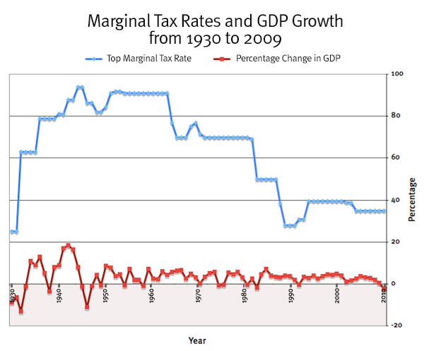

Slide 17
Problems with governments
-government might not allocate optimally- it will not be able to fully understand the “infinitely varying needs of the people.”
Might not be efficient. Government officials do not have a personal stake in success, like a business owner would, and thus are not as motivated to make a good decision.

Slide 18
Problems with markets
Inequality
Underproduction of public goods
Externalities.

